Slide 1
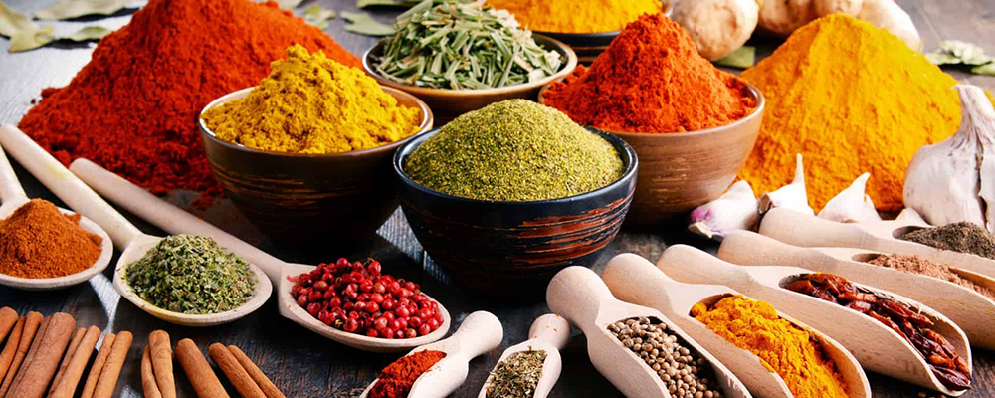
SPICES
CURRY LEAVES
Curry leaves are also known as Kari Patta and is the foliage of the curry tree (Murraya koenigii). This tree is native to India, and its leaves are used for both medicinal and culinary applications. It is used in many dishes in the Indian continent. They are highly aromatic and gives a unique flavor with notes of citrus. The curry leaves are used in numerous dishes and also has many health benefits such as reducing the risk of heart disease.
2. CINNAMON
Cinnamon is a delicious and popular spice with many impressive effects on health. It is found in many spice plantations and many other places in Goa. It is made from the inner bark of trees scientifically known as Cinnamon. Cinnamon is separated into two main categories: cassia cinnamon and Ceylon cinnamon, we are referring to cassia cinnamon, which is used in a lot of Indian dishes.
3. MACE
Mace is the lacy outer seed covering of a Nutmeg. It is removed by hand and then dried, and then it turns out to a yellowish-brown spice. Mace is a common ingredient in Indian cuisine and it really shines in savory dishes. It has a slightly warm taste and a similar fragrance as nutmeg. Mace's flavour is described as a combination of cinnamon and pepper and a more pungent version of nutmeg.
4. NUTMEG
Nutmeg is a popular spice made from the seeds of ‘Myristica fragrans’. It is most often sold as a ground spice. It has a distinctive pungent fragrance and a warm slightly sweet taste. It is used in dishes like sausages, sauces, vegetables, puddings etc.
5. BLACK PEPPER
Black pepper is also known as peppercorn. It holds more benefits than you'd imagine. It is usually dried and used as a spice and seasoning. It comes out with lot health benefits. It is available as whole or cracked peppercorns or ground into powder.

